Slide 1
Machine Learning Session-3
Decision Trees and Random Forest

Slide 2
Content
What is a Decision Tree?
How is Decision Tree made?
Math behind decision tree
Performance Metrics
Decision Tree code
What is a Random Forest?
How is Random Forest Built?
Parameters in Random Forest
Performance Metrics

Slide 3
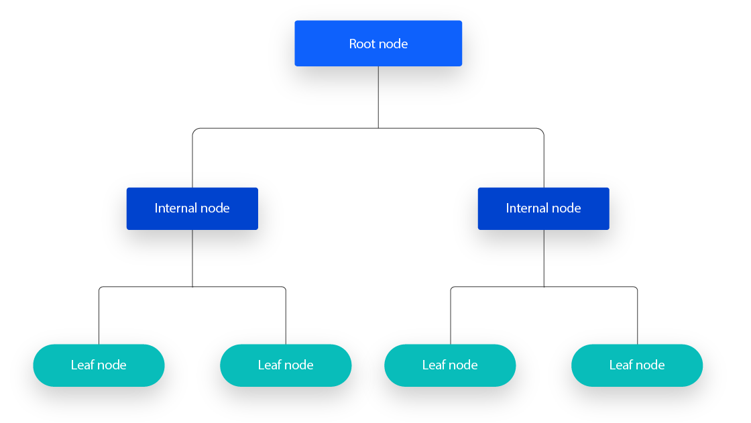
What is a decision tree?
A decision tree is a algorithmic structure used for decision-making and predictive modeling
It is a tree-shaped diagram where each internal node represents a decision (or test) on an attribute, each branch represents the outcome of that decision, and each leaf node represents a class label or outcome
Root Node: The starting point of the tree where decisions are made.
Splitting: Dividing the data into subsets based on the feature that provides the best separation.
Internal Nodes: These represent decisions or tests on a feature.
Leaf Nodes: The final decision or outcome of the tree.
Branches: The links between nodes that represent possible outcomes of a decision

Slide 4
Example of a decision tree?
Is it Night?
Is it raining?
Is it cold?
Wear formals
Wear Raincoat
on formals
Is it raining?
Is it raining?
No sweater or Raincoat
Wear Raincoat
Wear sweater
Wear Raincoat

Slide 5
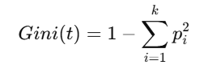
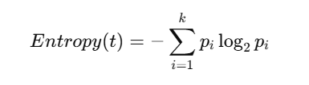
Decision Tree Classifier Algorithm
Decision tree algorithm uses GINI or ENTROPY + Information Gain metrics to decide on how to split at the node and what features are to be considered
Gini Index (Gini Impurity):
Here GINI is a measure used to measure the impurity in each node. Lower the GINI value, higher is the purity of node
In the above formula k is number of classes
Entropy
Entropy is used to measure uncertainty or disorder in the node. Lower entropy , higher is the homogeneity of the node

Slide 6
Decision Tree Regressor Algorithm
Uses either of the below loss functions:
Mean Square Error (MSE)
Mean Absolute Error(MAE)

Slide 7
Performance Metrics
Classifier:
Confusion Matrix
Precision, Recall, F1 Score
ROC Curve and AUC
Regressor:
RMSE
MSE
MAE

Slide 8
RAONDOM FOREST

Slide 9
Random Forest Model
Bootstrapping and
Random Feature Selection
Ensembling
Dtree 1
Classifier:
Majority Voting
Regressor:
Mean
Dataset
Dtree 2
Dtree 3
Dtree 4
M rows
N columns
Dtree 5
Dtree 6
Dtree 7

Slide 10
Pros and Cons
PROS
High Accuracy: By averaging the predictions of many trees, it reduces the risk of overfitting and more accurate than decision trees.
Handles Missing Data: Random forests can handle missing data in the features.
Works with High-Dimensional Data: They can be applied to datasets with many features.
Feature Importance: Random Forests can give insights into the importance of each feature in making predictions.
CONS
Interpretability of model: Only feature importance is the way
If you want a rule based as decision tree, it won’t be easy to identify from random forest

Slide 11
Important Hyperparameters
Classifier/ Regressor
Criterion: “gini”, “entropy”, “log_loss” for classifier, “squared_error”, “absolute_error” for regressor
n_estimators: The number of trees in the forest
max_depth: The maximum depth of each tree
min_samples_split: The minimum number of samples required to split an internal node
min_samples_leaf: The minimum number of samples required to be at a leaf node
max_features: The number of features to consider when looking for the best split
bootstrap: Whether bootstrap sampling is used when building trees
class_weight: for unbalanced samples

Slide 12
Code

